Slide 1
VelocityReport
{ Real time reporting made easy }

Slide 2
Tired of slow reporting solutions?
Slow to setup
Slow to build
Slow to run
Patrick Talbot / Servoy Stuff

Slide 3
Want to outgrow the competition?
Patrick Talbot / Servoy Stuff

Slide 4
Have you tried VelocityReport yet?
Patrick Talbot / Servoy Stuff

Slide 5
VelocityReport
{ Why is it better? }

Slide 6
Based on standards
XHTML, XML
CSS 2.1 + CSS 3 @Page extensions
Servoy JavaScript
PDF
Google charts
Patrick Talbot / Servoy Stuff

Slide 7
Best of breed Open Source Java libraries
Powerful and EASY templates with Velocity
Preview and PDF rendering with xhtmlRenderer
Charting with Google charts or Eastwood/JFreeChart
Barcode with Barcode4J
And a lot more…
Patrick Talbot / Servoy Stuff

Slide 8
The advantages of HTML
Easy to edit
Easy to style with CSS
Easy to add images/charts/barcodes
No need for specialized report designers
Can use any HTML editor
Flexible layout with tables and divs
The templates can be generated on the fly
Less memory overhead (lightweight text/xml)
Patrick Talbot / Servoy Stuff

Slide 9
VelocityReport
{ The technology }

Slide 10
Velocity in 10 seconds
$ = any variables
! = silent exceptions
. = object notation
#if
#else
#elseif
#end
#foreach
#set
#include
#parse
#macro
Patrick Talbot / Servoy Stuff

Slide 11
Servoy Objects that can be used
In the Velocity context used to render a template, you can put:
Foundsets
Records
Datasets
Arrays
Javascript Objects
Functions
Strings
Dates
media:/// images
Blob images (byte[])
Primitives (integer, float, boolean)
Charts
Barcodes
Patrick Talbot / Servoy Stuff

Slide 12
Helper objects
Helper objects (think RoR) are also auto-injected in the context and available in your templates:
$globals
$i18n
$date
$math
$number
$alternator
$plugin
$baseHREF
$htmlize.get() or #h() macro
Patrick Talbot / Servoy Stuff

Slide 13
Google charts vs Eastwood
Google charts
http://chart.googleapis.com/chart?cht=bvg&chs=250x150&chd=s:Monkeys&chxt=x,y&chxs=0,ff0000,12,0,lt|1,0000ff,10,1,lt
Web service API located on Google servers
Low DPI
Limited size for images (300,000 total pixels)
Limited GET URL size
Now accept POST but with 16k limit
Eastwood – uses JFreeChart
Web service installed on Servoy server
No limit on images size
No limit on URL size (tomcat have 64k limit for GET though)
Patrick Talbot / Servoy Stuff

Slide 14
VelocityReport charts
var barcode = plugins.VelocityReport.getChart( CHART.PIE, getPieChartDef, true, REPORT.RESOLUTION_HIGH) ;
function getPieChartDef() {
var chartDef = {};
chartDef.title = "i18n:piechart.title";
chartDef.threeD = false;
chartDef.slices = [
{percent: 30, color: '#FF0000', label: 'Thirty', legend: 'Thirty'},
{percent: 25, color: '#00FF00', label: 'Twenty-Five', legend: 'Twenty-Five'},
{percent: 15, color: '#0000FF', label: 'Fifteen', legend: 'Fifteen'},
{percent: 10, color: '#FF00FF', label: 'Five', legend: 'Five'},
{percent: 20, color: '#00FFFF', label: 'Twenty', legend: 'Twenty'}
];
chartDef.orientation = 45;
chartDef.margins = [10,10,10,30];
chartDef.legendMargins = [50,10];
return chartDef;
}
Patrick Talbot / Servoy Stuff

Slide 15
VelocityReport barcodes
var barcode = plugins.VelocityReport.getBarcode(barcodeDef);
var barcodeDef = {
data: "ServoyStuff",
gray: true,
type: BARCODE.CODE128,
height: 60,
pattern: "______-_____!",
moduleWidth: "0.18mm",
wideFactor: 3,
format: "png",
fontSize: 8,
forcedWidth: 225,
forcedHeight: 90,
id: "barcode1",
font: 'Courier+New',
resolution: REPORT.RESOLUTION_HIGH
}
Patrick Talbot / Servoy Stuff

Slide 16
Demo time!
Let’s have a look!
Patrick Talbot / Servoy Stuff

Slide 17
VelocityReport on ServoyForge
https://www.servoyforge.net/projects/velocity-report
Version 1.3.15
Free BSD License
svn://svn.servoyforge.net/velocity-report/
Patrick Talbot / Servoy Stuff

Slide 18
VelocityReport editor
{ How to create/edit templates }

Slide 19
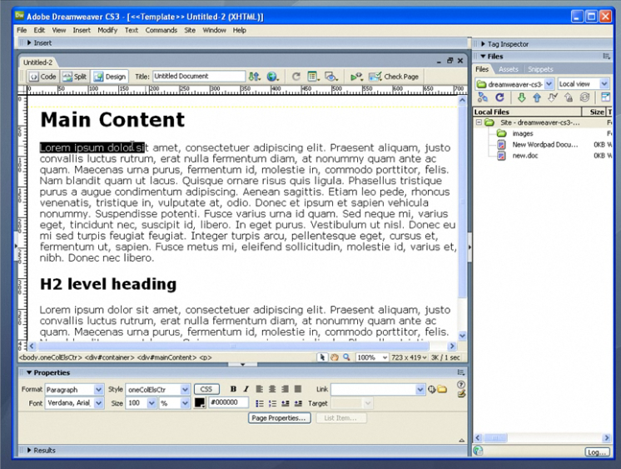
Velocity Report editors
Any HTML editor capable of XHTML output
Wysiwyg or text based.
Patrick Talbot / Servoy Stuff

Slide 20
A Servoy Velocity editor?
How about the ServoyHtmlBrowser from the BrowserSuite right inside Servoy?
Patrick Talbot / Servoy Stuff

Slide 21
At runtime?
Patrick Talbot / Servoy Stuff

Slide 22
ServoyHtmlEditor new capabilities
Adding custom buttons with browser-side JavaScript or callbacks to Servoy methods
In progress
Adding custom lists (dropdown) filled from Servoy values to insert variables
In progress
Adding pre-defined custom templates from Servoy
To come
Finding a way to add and edit loops
List of enhanced macros build up from Servoy callbacks?
Patrick Talbot / Servoy Stuff

Slide 23
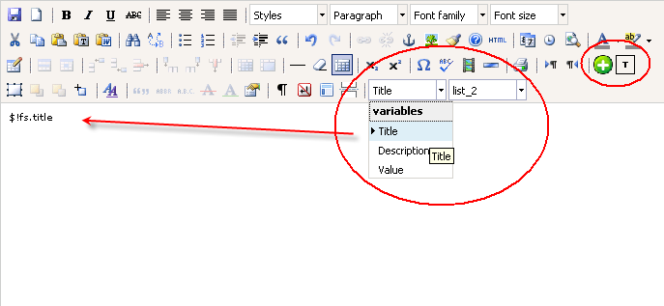
ServoyHtmlEditor new capabilities
Custom buttons and lists in TinyMCE:
Patrick Talbot / Servoy Stuff

Slide 24
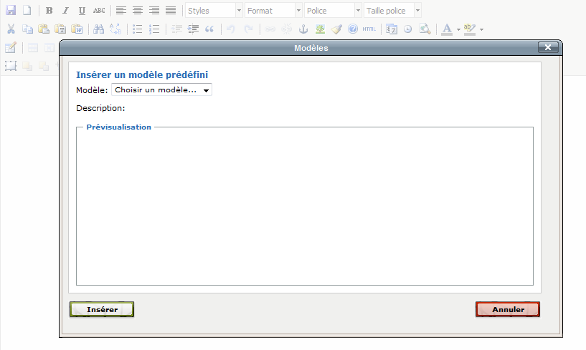
ServoyHtmlEditor new capabilities
Custom templates:
Patrick Talbot / Servoy Stuff

Slide 25
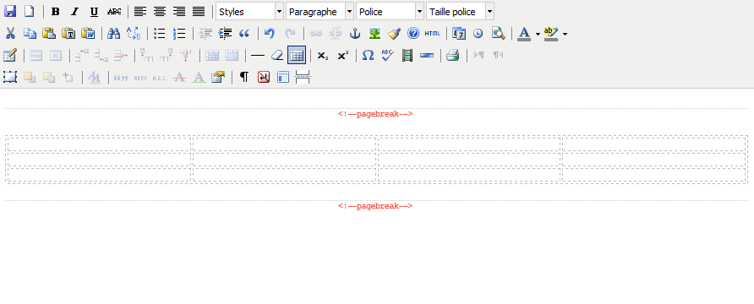
ServoyHtmlEditor new capabilities
Loops (wysiwyg edition?)
Patrick Talbot / Servoy Stuff

Slide 26
VelocityReport editor
If you are interested in a runtime report editor, I need your help!
Contact me: admin@servoy-stuff.net
Discuss on the VelocityReport forum on ServoyForge:
https://www.servoyforge.net/projects/velocity-report/boards
Patrick Talbot / Servoy Stuff

