Slide 1
Document Management with SmartDoc
{ A new dimension to Servoy index/search capabilities }

Slide 2
Document management
Your users produce tons of document in various format?
Word, Excel, PDF, html, xml, text, zip, jpeg, you name it!
But they are too lazy to categorize them properly in your document management app?
They don’t want to use your nice Servoy form.
You are always adding new categories and this looks like it will never end?
You are right, it will NEVER end!
Patrick Talbot (Servoy Stuff) & JC Sanchez (Stanford University)

Slide 3
Format hell
Different file formats mean different way of pulling data
<xml> <html>
%PDF
{\rtf1\adeflang1025\ansi
AA BF D8 FD BF F1 EA 00
Hard to extract the content!
Patrick Talbot (Servoy Stuff) & JC Sanchez (Stanford University)

Slide 4
SQL is not enough
You have tons of fields and relations inside your DB,
You have crafted some very clever search engine…
But when it comes to search the entire database, your server is on his knees?
Patrick Talbot (Servoy Stuff) & JC Sanchez (Stanford University)

Slide 5
Full text SQL is not enough
All results will score at the same level
There is a big overhead on the server
Are you really going to create full-text indexes on all your databases?
Patrick Talbot (Servoy Stuff) & JC Sanchez (Stanford University)

Slide 6
Introducing…
Patrick Talbot (Servoy Stuff) & JC Sanchez (Stanford University)

Slide 7
Introducing…
martDoc
Patrick Talbot (Servoy Stuff) & JC Sanchez (Stanford University)

Slide 8
The SmartDoc plugin
{ What’s inside the box? }

Slide 9
The fundation Apache projects
Lucene
The most powerful Java full text search engine library
Solr
Clever enterprise search platform built on top of Lucene
Tika
Amazing data extractor for Lucene/Solr
Patrick Talbot (Servoy Stuff) & JC Sanchez (Stanford University)

Slide 10
http://lucene.apache.org/
Open Source Apache License 2.0
Powered by Lucene:
http://wiki.apache.org/lucene-java/PoweredBy
Patrick Talbot (Servoy Stuff) & JC Sanchez (Stanford University)

Slide 11
A powerful Java library focused on indexing and searching document database of any type and size.
Analyzers
Stemmers
Term vectors
Frequency analysis
Query boosters, proximity,
Wildcards, ranges, boolean, regex, proximity, fuzzy searches
Filtering
Statistics
Patrick Talbot (Servoy Stuff) & JC Sanchez (Stanford University)

Slide 12
http://lucene.apache.org/solr/
Open Source Apache License 2.0
Powered by Solr:
http://wiki.apache.org/solr/PublicServers
Standalone or served by Tomcat (or Servoy :)
http://wiki.apache.org/solr/SolrTomcat
Patrick Talbot (Servoy Stuff) & JC Sanchez (Stanford University)

Slide 13
An enterprise search server with a web-services like API.
You put documents in it via XML over HTTP or from Servoy using the SmartDoc plugin.
You query it via HTTP GET or the SmartDoc plugin and receive XML results or JavaScript objects.
Advanced Full-Text Search Capabilities
Optimized for High Volume Web Traffic
Standards Based Open Interfaces - XML, JSON and HTTP
Comprehensive HTML Administration Interfaces
Server statistics exposed over JMX for monitoring
Scalability - Efficient Replication to other Solr Search Servers
Flexible and Adaptable with XML configuration
Extensible Plugin Architecture
Patrick Talbot (Servoy Stuff) & JC Sanchez (Stanford University)

Slide 14
Solr uses the Lucene Search Library and extends it!
Real Data Schema, with Numeric Types, Dynamic Fields, Unique Keys
Powerful Extensions to the Lucene Query Language
Faceted Search and Filtering
Advanced, Configurable Text Analysis
Highly Configurable and User Extensible Caching
Performance Optimizations
External Configuration via XML
Administration Interface
Monitorable Logging
Fast Incremental Updates and Index Replication
Highly Scalable Distributed search with sharded index across multiple hosts
XML, CSV/delimited-text, and binary update formats
Easy ways to pull in data from databases and XML files from local disk and HTTP sources
Multiple search indices
Patrick Talbot (Servoy Stuff) & JC Sanchez (Stanford University)

Slide 15
A good example of faceted search:
Search Lucene/Solr docs with Solr
http://www.lucidimagination.com/search/ *
* Lucid Imagination is the first commercial entity exclusively dedicated to Apache Lucene/Solr enterprise search technology.
Patrick Talbot (Servoy Stuff) & JC Sanchez (Stanford University)

Slide 16
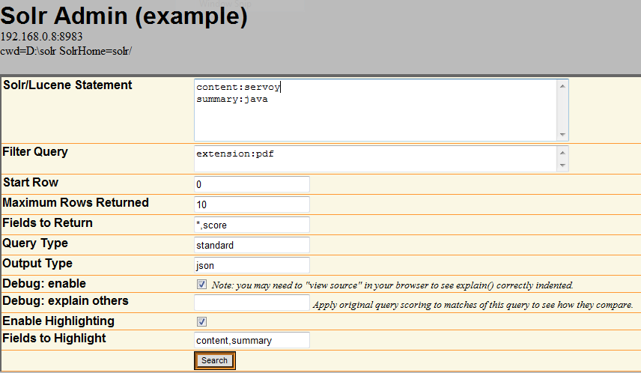
Patrick Talbot (Servoy Stuff) & JC Sanchez (Stanford University)

Slide 17
http://tika.apache.org/
Open Source Apache License 2.0
Supported formats:
http://tika.apache.org/0.8/formats.html
Patrick Talbot (Servoy Stuff) & JC Sanchez (Stanford University)

Slide 18
A toolkit for detecting and extracting metadata and structured text content from various documents using existing parser libraries.
Under high development (current version is 0.8)
Aggregates the best java parsers available into one simple unified API
Auto-detects document formats and encodings
A library of libraries: beware! this is huge (26.7 Mb)!
The good news is that it will stay server-side
Patrick Talbot (Servoy Stuff) & JC Sanchez (Stanford University)

Slide 19
Let’s give it a try!
Patrick Talbot & Juan-Carlos Sanchez

Slide 20
Document management with SmartDoc
{ The plugin }

Slide 21
SmartDoc plugin architecture
Patrick Talbot (Servoy Stuff) & JC Sanchez (Stanford University)

Slide 22
SmartDoc plugin architecture
Servoy asks the plugin to index some files and/or urls
The plugin starts a new Thread to do the job and the Servoy client is freed
One at a time, each file/url is sent to the server for indexing
If a file, streamed by chunks to the server, if a url, sent for the server to retrieve the content
The plugin talks to a specific Thread on the server.
Patrick Talbot (Servoy Stuff) & JC Sanchez (Stanford University)

Slide 23
SmartDoc plugin architecture
If a file, the server Thread retrieves the chunks of files and stores them on the File System
If a url, a connection is opened to retrieve the content and stores that as well
Parsing of the content and the metadata is done using the Tika library
Then a call to the Solr server (using object invocation – SolrJ) updates the data in the Solr/Lucene index
Patrick Talbot (Servoy Stuff) & JC Sanchez (Stanford University)

Slide 24
SmartDoc plugin architecture
Solr returns the data indexed with metadata
These data sets are optionally cascaded back to the client from the server Thread to the client Thread to a callback to a Servoy method
The Servoy method receives a JavaScript Result object, which contains the result of the indexing
The Servoy method can do whatever it wants with these data sets: store in an alternate DB, save to file, present to the user, etc.
Patrick Talbot (Servoy Stuff) & JC Sanchez (Stanford University)

Slide 25
Alternate path (parse helper)
Patrick Talbot (Servoy Stuff) & JC Sanchez (Stanford University)

Slide 26
SmartDoc demo
Let’s have a look!
Patrick Talbot (Servoy Stuff) & JC Sanchez (Stanford University)

Slide 27
Document management with SmartDoc
{ The RobotLaw solution }

Slide 28
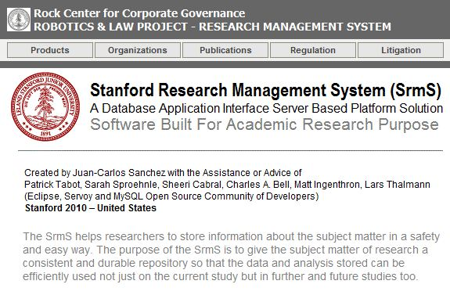
Document management with SmartDoc
{ The RobotLaw application }
Patrick Talbot (Servoy Stuff) & JC Sanchez (Stanford University)

Slide 29
Document management with SmartDoc
{ The RobotLaw application }
Real world System used at Standford Law School
Based on the SmartDoc plugin capabilities
Written by Juan-Carlos Sanchez
Patrick Talbot (Servoy Stuff) & JC Sanchez (Stanford University)

Slide 30
Document management with SmartDoc
{ The RobotLaw application }
About RobotLaw
The goal of the RobotLaw project is to create a central repository that houses information about the actual "products" and characteristics of various robots/robotic devices available in the marketplace and links that to various regulatory, public policy, and legal issues as they emerge in this field. This repository is meant to be a jumping-off point for other related research and a "go to" source to learn about and/or verify the history/pedigree of (some/many) robots and robotics related products.
Patrick Talbot (Servoy Stuff) & JC Sanchez (Stanford University)

Slide 31
Document management with SmartDoc
{ The RobotLaw application }
What is RobotLaw from the technical standpoint? RobotLaw is built on top of what Juan-Carlos calls “Research Management System” or RMS. The RMS is a "researcher driven" CMS application with a core back-end database, a dynamic UI with document processing capabilities and a “dynamic” relational database and file storing systems.
All of it is built on top of … guess what?
Servoy
Patrick Talbot (Servoy Stuff) & JC Sanchez (Stanford University)

Slide 32
Document management with SmartDoc
{ The RobotLaw application }
But Servoy is not enough! The RMS consists of three components - or plugins and modules:
SmartDoc
SmartAgent
SmartDummy
* Today we I am not explaining the RMS and its components. This will have to wait until next year!
Next… more about the SmartDoc
Patrick Talbot (Servoy Stuff) & JC Sanchez (Stanford University)

Slide 33
Document management with SmartDoc
{ The RobotLaw application }
COMPONENTS
Transfer management utility
Files management utility
Embedded crawling and parsing
Document converter utility (Under construction)
USE
Upload documents from desktop or URL into the system’s directories
Create and remove (manage) directories and files located in the system’s directories
Store content in the database
Patrick Talbot (Servoy Stuff) & JC Sanchez (Stanford University)

Slide 34
Document management with SmartDoc
{ The RobotLaw application }
SmartDoc Processing
www.doc.com
Master DB
("EPS") growth for its 1stQ and 2ndQ of Fiscal 1997 ("F97") in excess of prevailing analysts' estimates, attributing these spectacular results to extraordinarily strong demand for 3Com's Fast Ethernet Adapter Cards, stackable hubs and switches, as well as the relative price stability
.pdf or .html
file
.pdf or .html
file
("EPS") growth for its 1stQ a
System
Directory
1. With drag and drop, the user moves document or its URL into the interface for the SmartDoc to do its job.
2. SmartDoc extracts and stores the entire “consumable” content in the database
3. SmartDoc sends the PDF or HTML file into a system directory and into the Web Server for publishing
Web Server
Patrick Talbot (Servoy Stuff) & JC Sanchez (Stanford University)

Slide 35
Document management with SmartDoc
{ The RobotLaw application }
SmartDoc extracts the metadata and the entire content of the files and parse them into their respective fields in the database. With the use of the Browser Bean and Servoy’s data binding capability, the data is immediately ready for view, search and the files ready to be downloaded by any other user around the world!
UNITED STATES DISTRICT COURT
NORTHERN DISTRICT OF CALIFORNIA
SAN JOSE DIVISION
ADOLFO MARTIN EUREDJIAN, NORMAN
HIRSCH, RICHARD LOWINGER, ROBERT
SCHWARTZ, LARRY MORRISON,
CHARLES N. PATTISON, BARRY
NAIDITCH and MAE S. NAIDITCH,
On Behalf of Themselves and All Others
Similarly Situated,
Plaintiffs,
vs.
3COM CORPORATION, DEBRA J. ENGEL,
ROBERT J. FINOCCHIO, JR., JOHN H.
HART, STEPHEN C. JOHNSON, RICHARD
W. JOYCE, CHRISTOPHER B. PAISLEY,
JANICE M. ROBERTS, DOUGLAS C.
SPRENG, ERIC A. BENHAMOU and
ALAN J. KESSLER,
Defendants.
_______________________________________
No. C-98-0508-CB
[filed Feb. 9, 1998]
CLASS ACTION
COMPLAINT FOR
VIOLATION OF THE
SECURITIES EXCHANGE
ACT OF 1934
Plaintiffs Demand
A Trial By Jury
INTRODUCTION AND OVERVIEW
1. This is a securities class action on behalf of all purchasers of the common stock of 3Com Corporation ("3Com" or the "Company") which sells computer networking equipment, during the period from Sept. 24, 1996 through Feb. 10, 1997, inclusive (the "Class Period"). During the Class Period, 3Com reported revenue and earnings per share ("EPS") growth for its 1stQ and 2ndQ of Fiscal 1997 ("F97") in excess of prevailing analysts' estimates, attributing these spectacular results to extraordinarily strong demand for 3Com's Fast Ethernet Adapter Cards, stackable hubs and switches, as well as the relative price stability for those products. 3Com also raised its gross margin operating model to 53%-55% due to this purportedly strong demand and price stability, forecasting its operations would be at the high end of its targeted gross margin range for several quarters and that its 3rdQ and 4thQ F97 revenues and EPS would increase sequentially and reach higher levels than earlier forecast. As a result, 3Com's stock was a spectacular performer, skyrocketing from about $52 per share just before the beginning of the Class Period to a Class Period high of $81-3/8 per share in mid-Dec. 1996 -- a 52% increase in just 2-1/2 months. As 3Com's stock skyrocketed to its all-time high level, the ten 3Com insiders named as defendants sold off 896,000 shares of their 3Com stock at as high as $78-1/8 per share, pocketing $59.3 million in illegal insider-trading proceeds, while 3Com itself issued (sold) 3.9 million of its shares at $66 per share to acquire OnStream Networks, and defendants attempted, albeit unsuccessfully, to close their ongoing negotiations to have 3Com acquire U.S. Robotics for over $7 billion in the then-inflated market value of 3Com stock. In early Feb. 1997, 3Com's stock began to collapse as rumors circulated that there was severe price cutting in 3Com's Fast Ethernet Adapter Card market and that 3Com's business was performing much more poorly than had been publicly disclosed. Then, on Feb. 10, 1997, 3Com admitted that its 3rdQ F97 revenues would decline from 2ndQ levels and its EPS would be much worse than earlier forecast, due to severe price cutting for its Fast Ethernet Adapter Cards and weak demand for Adapter Cards, stackable hubs and switches, and that 3Com could not forecast when its business would recover. Upon these revelations, 3Com's stock collapsed to $37 per share on 36 million shares trading volume, the biggest one-day decline on the largest one-day stock volume in 3Com's history as a public company.
JURISDICTION AND VENUE
13. Jurisdiction exists pursuant to §27 of the Securities Exchange Act of 1934 ("Exchange Act"), 15 U.S.C. §78aa, and 28 U.S.C. §1331. The claims asserted arise under §§10(b) and 20(a) of the Exchange Act, 15 U.S.C. §§78j(b) and 78t(a), and Rule 10b-5.
14. (a) Venue is proper in this District pursuant to §27 of the Exchange Act and 28 U.S.C. §1391(b). Many of the acts giving rise to the violations complained of occurred in this District; and
(b) Assignment of this action to the San Jose Division is appropriate as a substantial part of the events or omissions identified herein occurred in Santa Clara County.
15. Defendants used the instrumentalities of interstate commerce, the U.S. mails and the facilities of the national securities markets
THE PARTIES
16. (a) Plaintiff Adolfo Martin Euredjian purchased 600 shares of 3Com stock on Jan. 28, 1997 at $62-7/8 per share, 700 shares on Jan. 31, 1997 at $67-3/8 per share and 800 shares on Feb. 4, 1997 at $53-1/2 per share, and was damaged thereby.
(b) Plaintiff Norman Hirsch purchased 500 shares of 3Com stock on Jan. 29, 1997 at $62-1/2 per share and was damaged thereby.
(c) Plaintiff Richard Lowinger purchased 500 shares of 3Com stock on Feb. 7, 1997 at $50-1/4 per share and was damaged thereby.
(d) Plaintiff Robert Schwartz purchased 100 shares of 3Com stock on Feb. 7, 1997 at $50-1/2 per share and was damaged thereby.
... and search and view
SCAC Core DB
(Master DB)
Jurisdiction exists pursuant to §27 of the Securities Exchange Act of 1934 ("Exchange Act"), 15 U.S
.C. §78aa, and 28 U.S.C. §1331. The claims asserted arise under §§10(b) and 20(a) of the Exchange Act, 1
Jurisdiction exists pursuant to §27 of the Securities Exchange Act of 1934 ("Exchange Act"), 15 U.S
.C. §78aa, and 28 U.S.C. §1331. The claims asserted arise under §§10(b) and 20(a) of the Exchange Act, 1
Patrick Talbot (Servoy Stuff) & JC Sanchez (Stanford University)

Slide 36
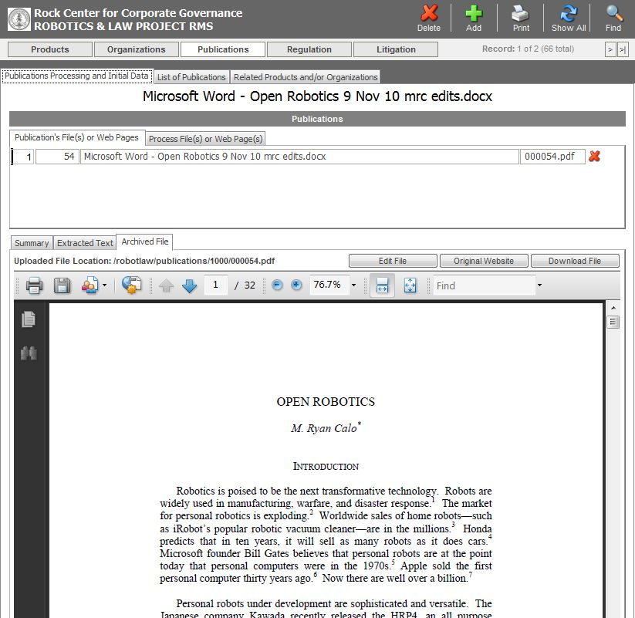
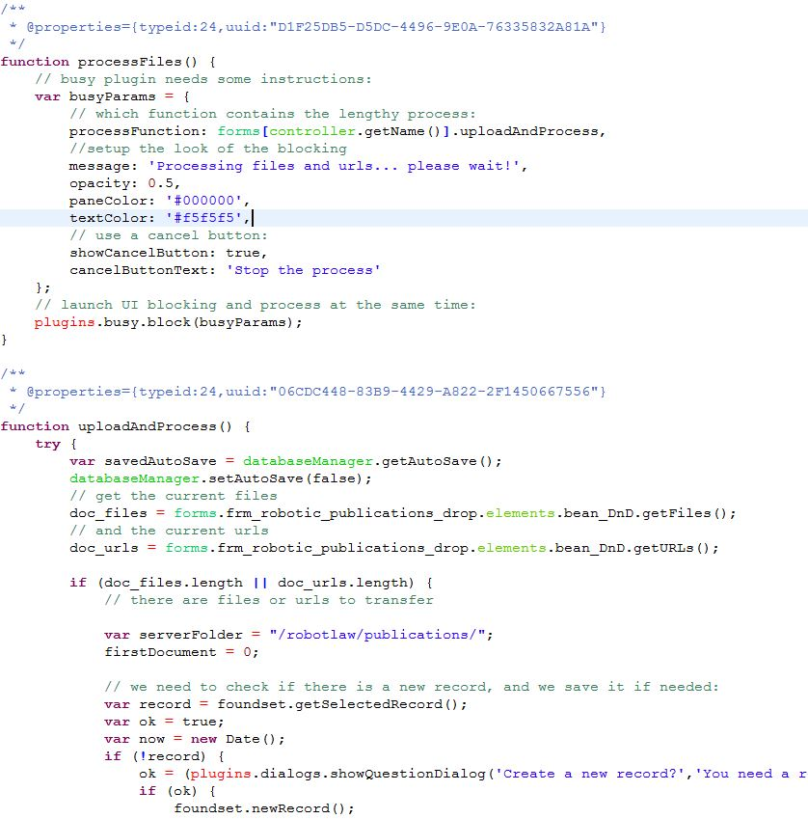
Document management with SmartDoc
{ The RobotLaw application }
Demo
Some code!
Patrick Talbot (Servoy Stuff) & JC Sanchez (Stanford University)

Slide 37
SmartDoc on ServoyForge
https://www.servoyforge.net/projects/smartdoc
Version 0.8
Free BSD License
svn://svn.servoyforge.net/smartdoc/
Patrick Talbot (Servoy Stuff) & JC Sanchez (Stanford University)

